Slide 1
Research question:
Is the implied volatility per option correlated to reddit sentiment?
Specifics:
Option list is provided.
Only the WSB subreddit is examined.
Sentiment can be generated by NLP or quantified by other indicators.
Looking for correlation, not causation.
Two approaches to tackle the research question:
Statistics - Regression techniques are considered for hypothesis testing of correlation.
ML – Wide variety of techniques but shortage of data can be limiting.

Slide 2
REGRESSION ANALYSIS
Multilinear regression
Simple
Equivalent to estimation of the Pearson’s correlation
Assumes normal distribution for Y (this can be prohibiting for non-negative Y’s, but simple feature conversions can allow application).
Generalized Linear Models
More complicated
Allow for non-linear relationship between X-Y while still preserving the ease of non-linear analysis.
Allow for more distributions of Y.
Plan: use GLM only in case no multilinear regression effort proves fruitful.

Slide 3
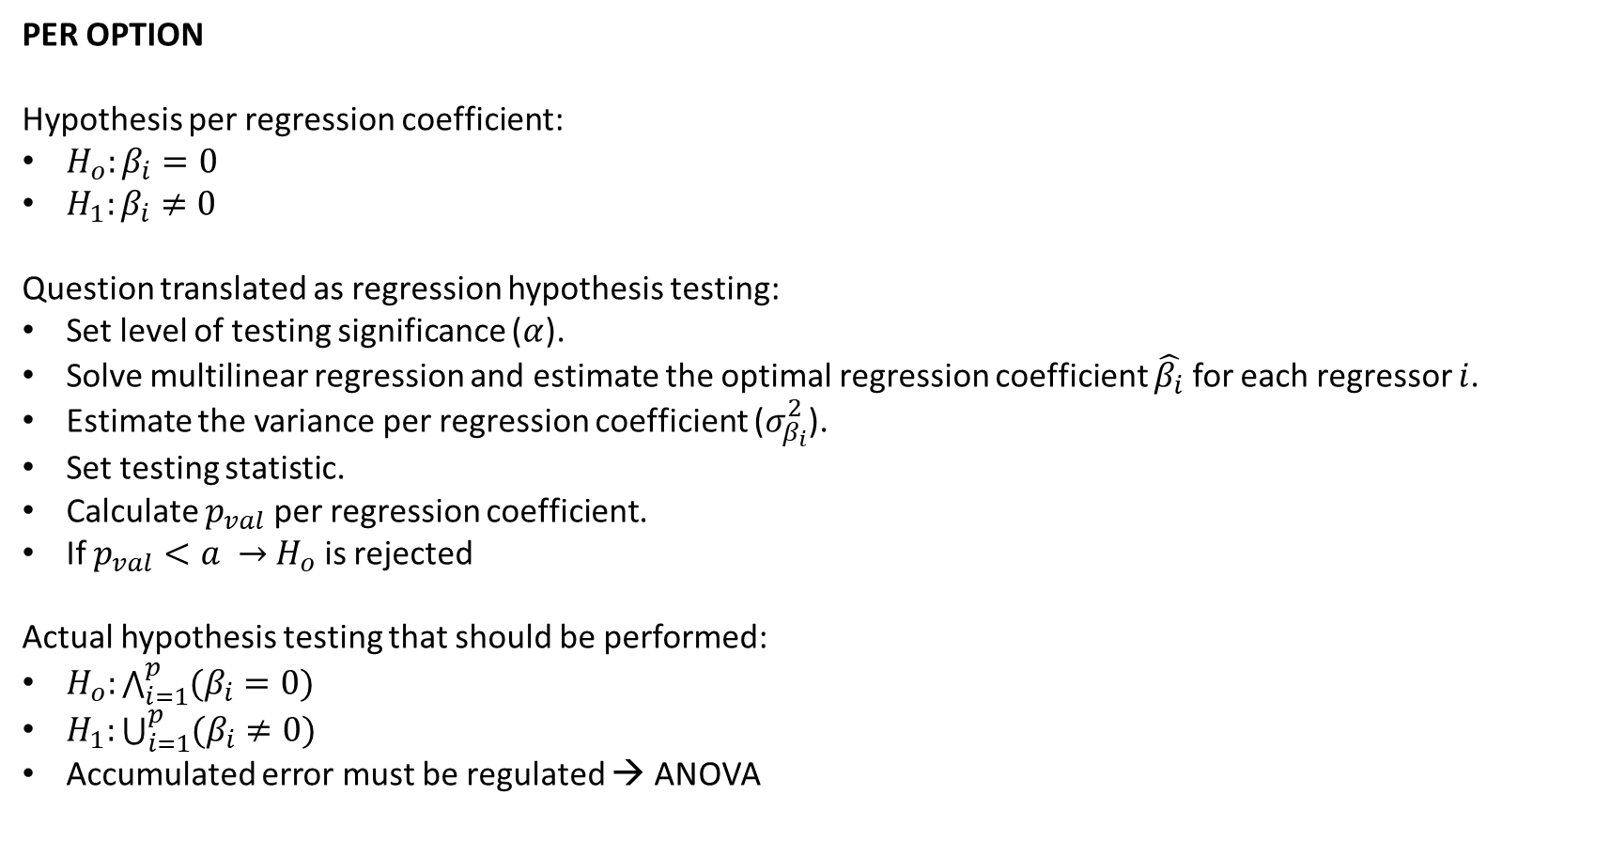
PER OPTION
Hypothesis per regression coefficient:
$H_{o}:β_{i}=0$
$H_{1}:β_{i}≠0$
Question translated as regression hypothesis testing:
Set level of testing significance ($α$).
Solve multilinear regression and estimate the optimal regression coefficient $\hat{β_{i}}$ for each regressor $i$.
Estimate the variance per regression coefficient ($σ_{β_{i}}^{2}$).
Set testing statistic.
Calculate $p_{val}$ per regression coefficient.
If $p_{val}<a →$ $H_{o}$ is rejected
Actual hypothesis testing that should be performed:
$H_{o}:\bigwedge_{i=1}^{p}{(β_{i}=0)}$
$H_{1}:\bigcup_{i=1}^{p}{(β_{i}≠0)}$
Accumulated error must be regulated → ANOVA

